Slide 1

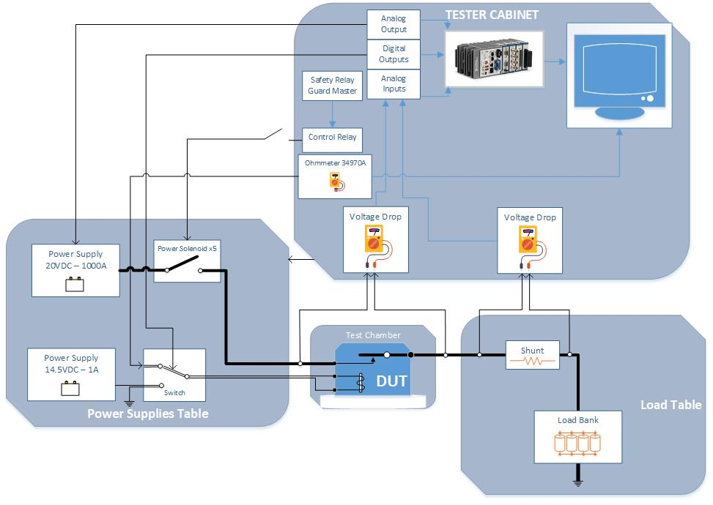
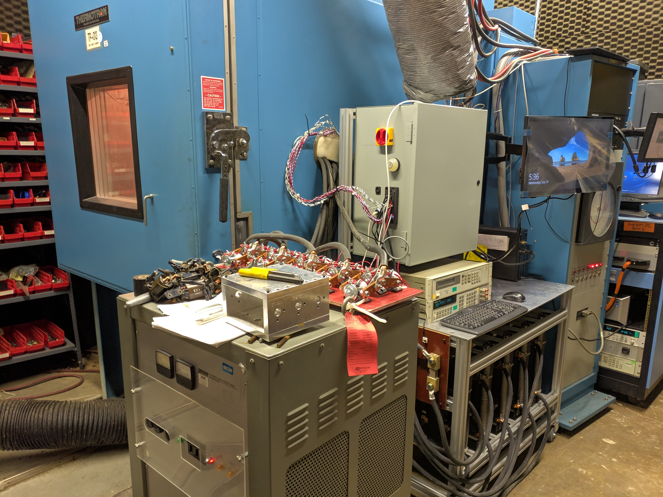
Grid Heater Solenoid Quality Tester
By: Luis Chachayma
PROJECT OVERVIEW
Quality verification of auto parts is important to guarantee vehicle safety and satisfaction. Some parts are required to be tested at extreme environmental conditions to verify its correct functioning.
The project was to develop a test station to test 5 solenoids at a time. The solenoids were subject to the following test:
Thermal Shock: Verify that the relay's functional performance is not compromised after exposure to non-operating sudden temperature changes from -40°C to 125°C.
Vibration: Verify that the relay's functional performance is not compromised after exposure to the operating and non-operating class 1 temperature/vibration profile.
High Temp – High Humidity: Withstand 664 hours at 85°C & 90% RH with relays operational 1 out of every 48 hours.
Thermal Humidity: Verify functional performance of relay in situations that can cause humidity condensation or frost conditions.
Mechanical Shock: Verify that the relay's functional performance is not compromised after exposure to mechanical shock stresses.
The LabVIEW program has to control all the equipment to synchronize the testing precisely.
Up next, the parts were tested according to the DVP&R document
Finally, the report was handed out to the managers.
General Diagram of the test setup
IMPLEMENTATION STEPS
To start a timeline was defined according to the requirements of the project. Also a general diagram was created with the equipment available un the Quality Laboratory. This was presented to the managers for approval.
Later the wiring diagram was created in OrCAD. At the same time the 3D model was created in Solidworks.
The diagrams were presented to the technicians for assembling.
Once the tester was assembled the LabVIEW programming started.
Tester implemented
Notes:
1

